Slide 1
3000x3000x300m grid
Without pumping
Obs 4
WTD: 51.6 m
K: 8.4 m/d
(0,2600)
K1 = 11 m/d
K2 = 5 m/d
K3 = 1 m/d
Obs 3
WTD: 50.2 m
K: 1 m/d
(2300,2300)
dx = 100m
dy = 100m
dz = 300 m
Assumptions
Wildcat farm is approximately square
ACME is approximately twice as tall as wide
Hydraulic conductivity gradient can be represented by three averaged constant-K zones
(0,2500)
(1000,2500)
Farm 2
1800 m
Direction of GW flow w/o pumping
1000 m
(0,700)
(1000,700)
(1500,500)
(1800,500)
Obs 2
WTD: 5.4 m
K: 13 m/d
(24,0)
Wildcat
Obs 1
WTD: 4.8 m
K: 1.5 m/d
(2400,0)
y
400 m
300 m
Datum(0,0)
(1500,100)
(1800,100)
x

Slide 2
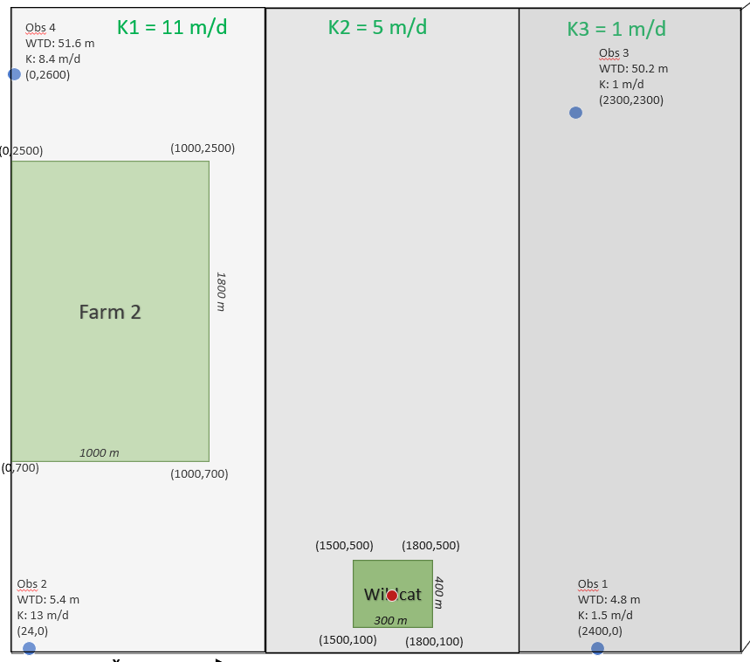

Slide 3
3000x3000x300m grid
Without pumping
Obs 4
WTD: 51.6 m
K: 8.4 m/d
(0,2600)
K1 = 11 m/d
K2 = 5 m/d
K3 = 1 m/d
Obs 3
WTD: 50.2 m
K: 1 m/d
(2300,2300)
dx = 100m
dy = 100m
dz = 300 m
Assumptions
Wildcat farm is approximately square
ACME is approximately twice as tall as wide
Hydraulic conductivity gradient can be represented by three averaged constant-K zones
(0,2500)
(1000,2500)
Farm 2
1800 m
Direction of GW flow w/o pumping
1000 m
(0,700)
(1000,700)
(1500,500)
(1800,500)
Obs 2
WTD: 5.4 m
K: 13 m/d
(24,0)
Wildcat
Obs 1
WTD: 4.8 m
K: 1.5 m/d
(2400,0)
y
400 m
300 m
Datum(0,0)
(1500,100)
(1800,100)
x

Slide 4
3000x3000x300 m grid
Obs 1
WTD: 4.8 m
K: 1.5 m/d
(2400,50)
Obs 2
WTD: 5.4 m
K: 13 m/d
(24,0)

Slide 5
Direction of GW flow
25x25x30 grid
1 cell = 100m
dx = 100 m
dy = 100 m
dz = 300 m
Obs 1
WTD: 4.8 m
K: 1.5 m/d
(0,24)
Obs 3
WTD: 50.2 m
K: 1 m/d
(23,23)
K = 1 m/d
1.5x1.5
Q1
Wildcat
Left Boundary
Constant head = 5 m
K = 6 m/d
Right Boundary
Constant head = 51 m
Boundary head should actually be thickness minus wtd
(1,15)
Assumptions
Wildcat farm is approximately square
ACME is approximately twice as tall as wide
Hydraulic conductivity gradient can be approximated by three averaged constant-K zones
3x5
ACME
Q2
K = 11 m/d
Obs 2
WTD: 5.4 m
K: 13 m/d
(0,0)
Obs 4
WTD: 51.6 m
K: 8.4 m/d
(25,0)
Q3
(7,0)

Slide 6
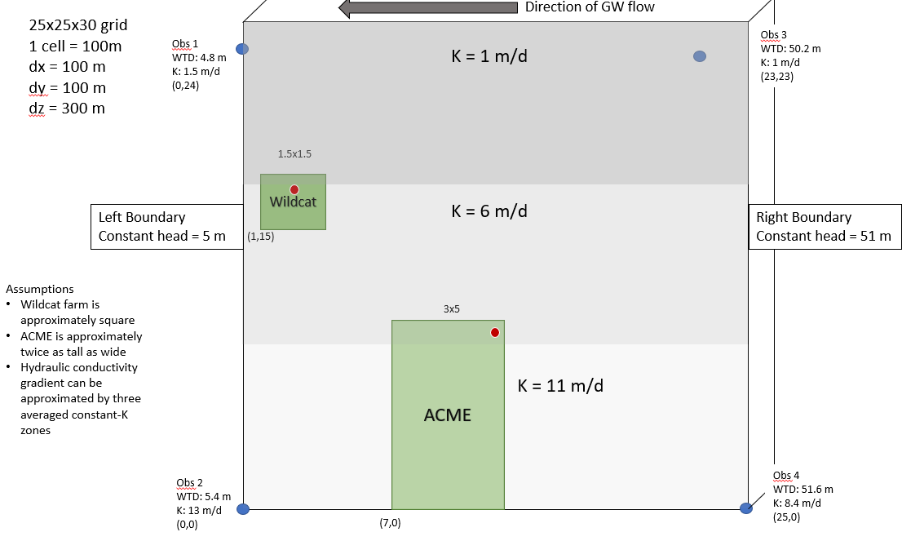
Wildcat Farm
Q = -20 m^3/day
Recharge = 5e-4
ET = Background ET = 5e-5
ACME Farm
Q1 = -20 m^3/day
Recharge = 5e-4
ET = Background ET = 5e-5
Q2 = -25 m^3/day

Slide 7
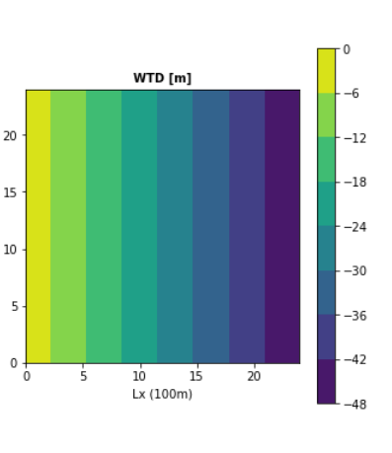
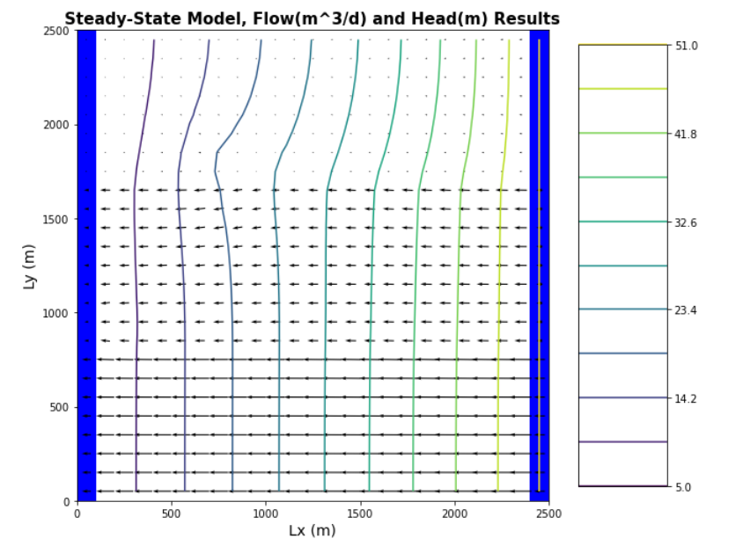
Pumping Wildcat well
w/o irrigation or recharge

